Slide 1

Requested by Islington Council 12.06.2020
How does
Galaxius work
Fashion-Enter Limited
1

Slide 2
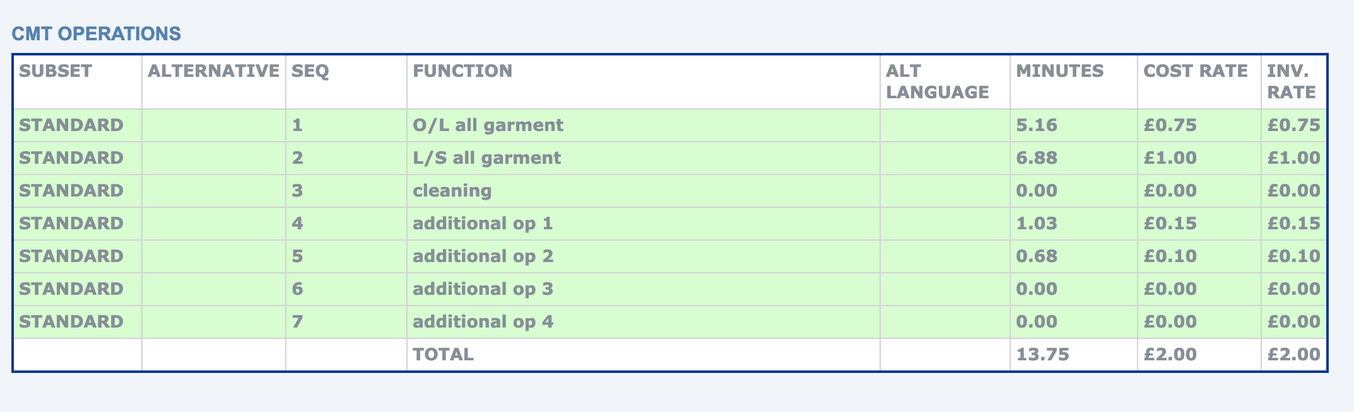
Galaxius
Galaxius was created by an independent IT consultant and supported by Fashion-Enter Ltd in 2016. The development period took four years and prior to Galaxius being implemented Fashion Enter could not make the factory be competitive and work effectively on a traditional hour rate pay. Galaxius allows performance related pay to occur which is standard in the industry but there is a mix of factories that pay a set per hour price and a piece rate. Galaxius is totally transparent and ethical allowing Fashion-Enter to be the only factory in the UK with a leading status in the Fast Forward Audit.
  Galaxius is a on-line system where orders are tracked
  Fabric & trims are ordered through the system. Once fabric & trims arrive, you can upload delivery notes.
  Size ratio order, cut quantity is listed on one page – allows you to follow through until order is dispatched
  Operations are inputted into each style; a price is put against this operation and this is what the machinist is paid

Slide 3
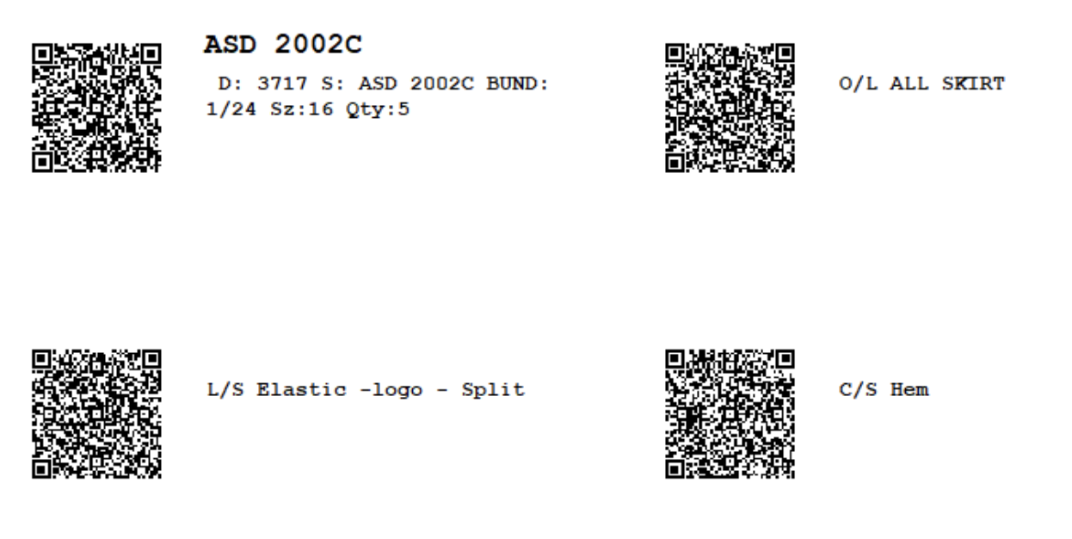
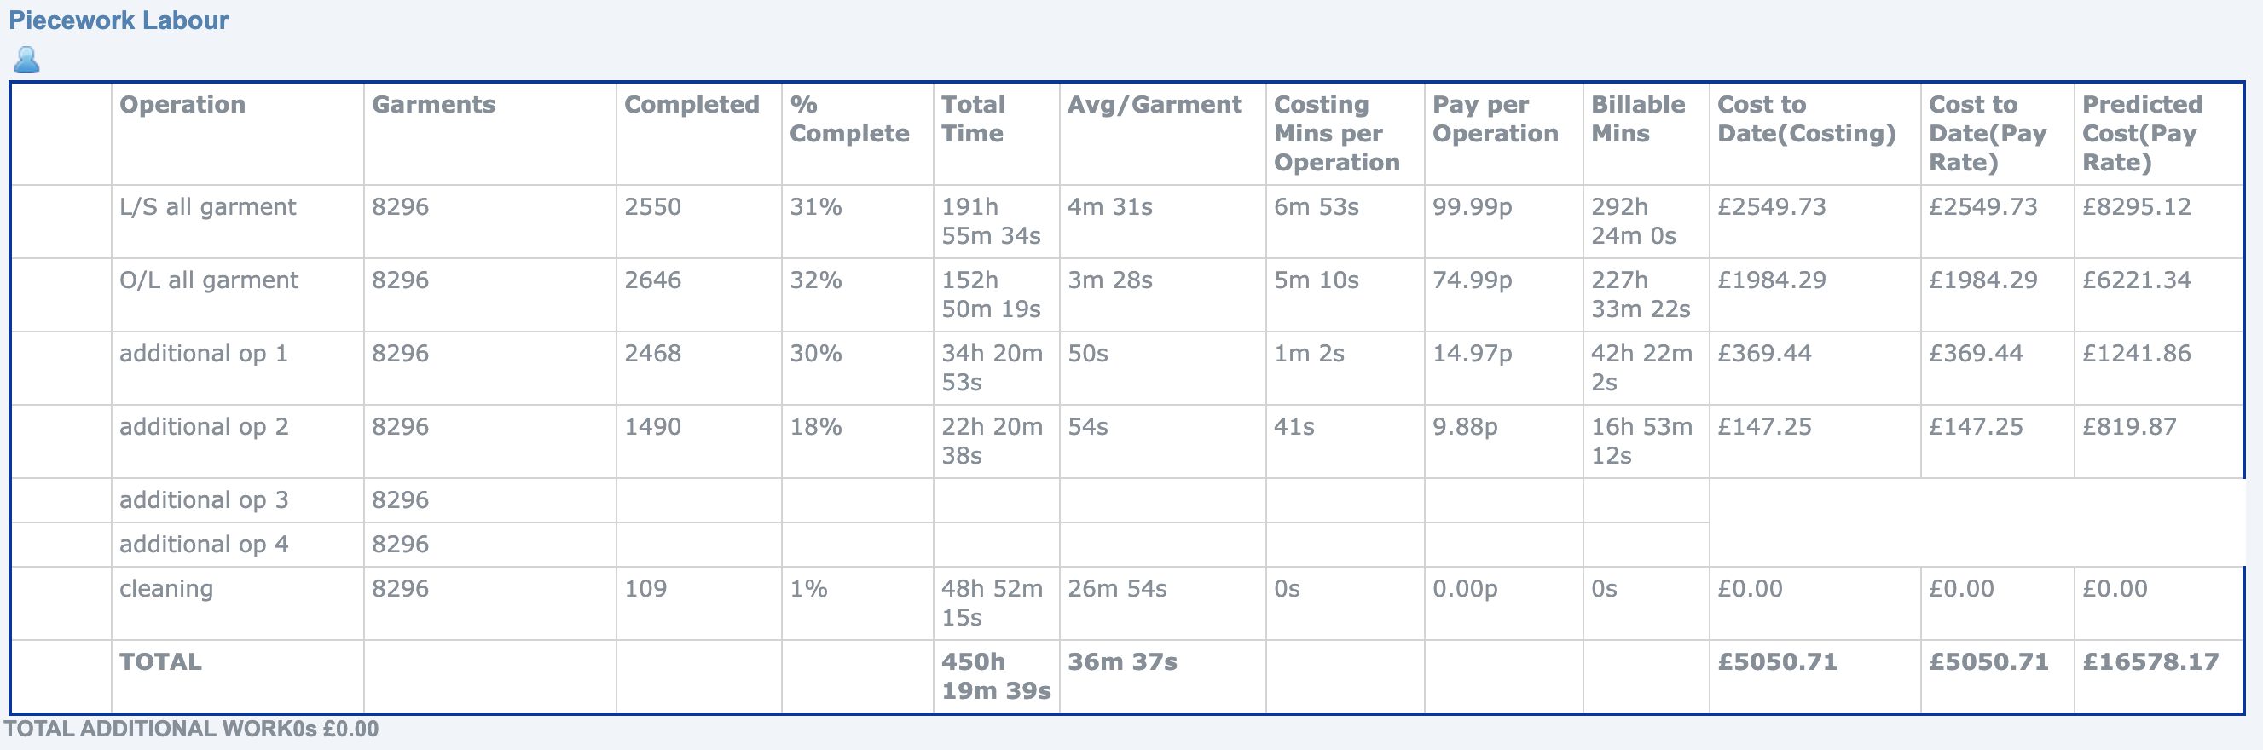
  Once cutting figures are inputted, barcodes sheets are generated with the operations on. One sheet is printed for each bundle and this stays with the bundle until garments are packed.
  Each operator has a mobile phone and scans in the bar code for each bundle providing a definitive time for each operation and machinist and the information is then stored on the cloud.
  Scanning also allows you to see how far through machining a style is

Slide 4
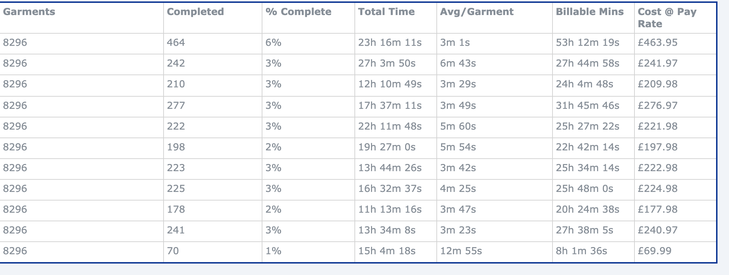
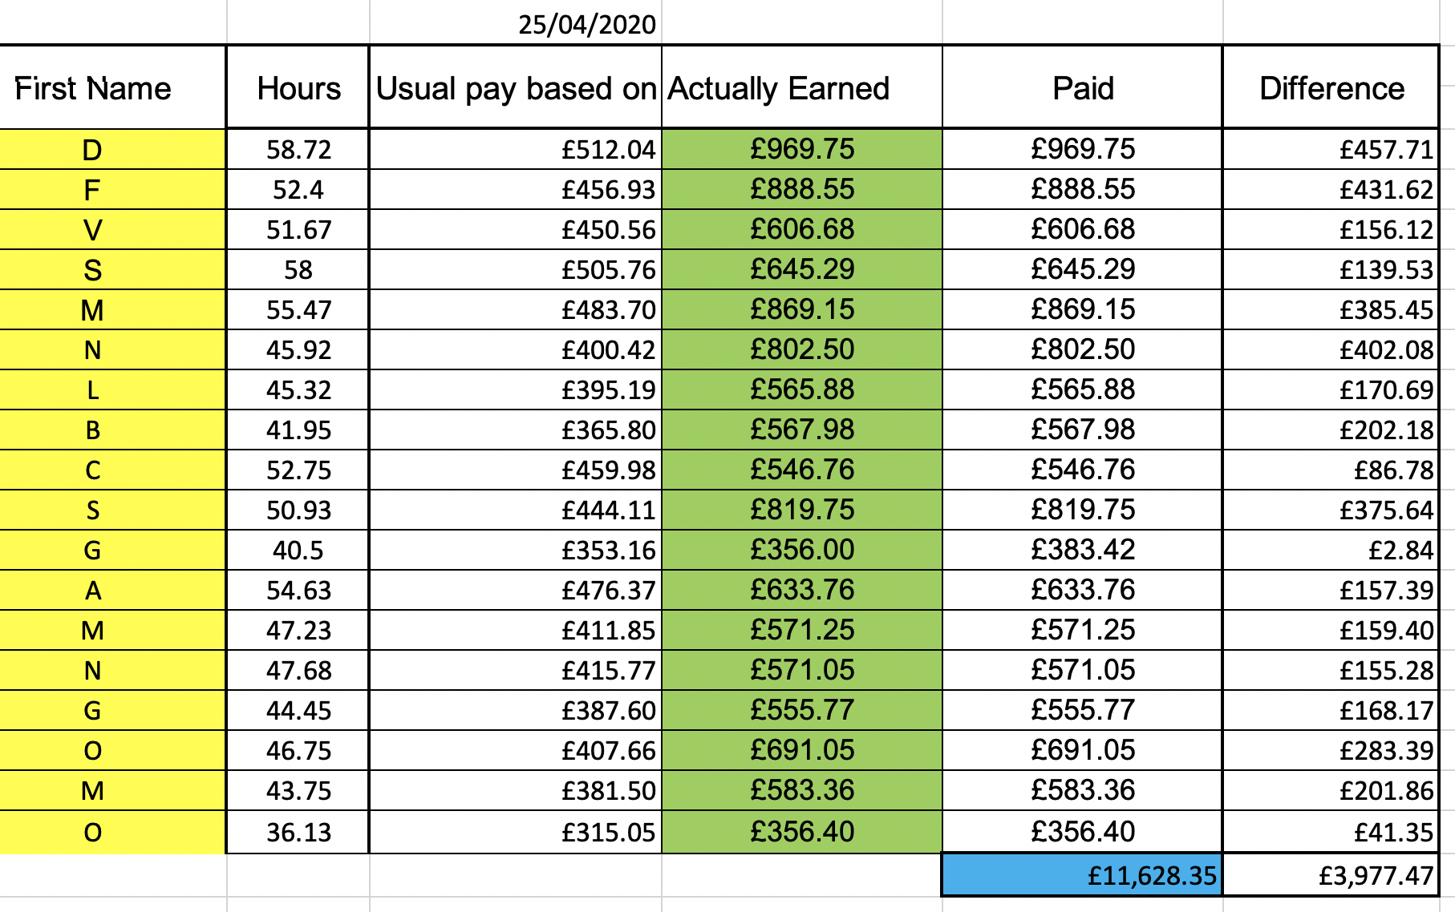
  Machinists will scan each bundle they machine, and this is what they are paid against
  If any machining faults are found, Galaxius allows you to see which machinist has done the work; the bundle is then given back for repair
  Machinists will scan each bundle they machine, and this is what they are paid against
  If any machining faults are found, Galaxius allows you to see which machinist has done the work; the bundle is then given back for repair

Slide 5

Let's get social!
CONTACT US
Headquarters
Unit 4, 13 & 14 Crusader Estate, 167 Hermitage Road, London, N4 1LZ
Landline
0208 809 3311
Email
Education@fashion-enter.com
@FTALONDON
FASHIONTECHNOLOGYACADEMY
@FTALONDON
@FASHIONTECHNOLOGYACADEMY
14

