Slide 1
November 2022
Fashion-Enter LTD
Greenwashing & Sustainability
CEO, Jennifer Holloway

Slide 2

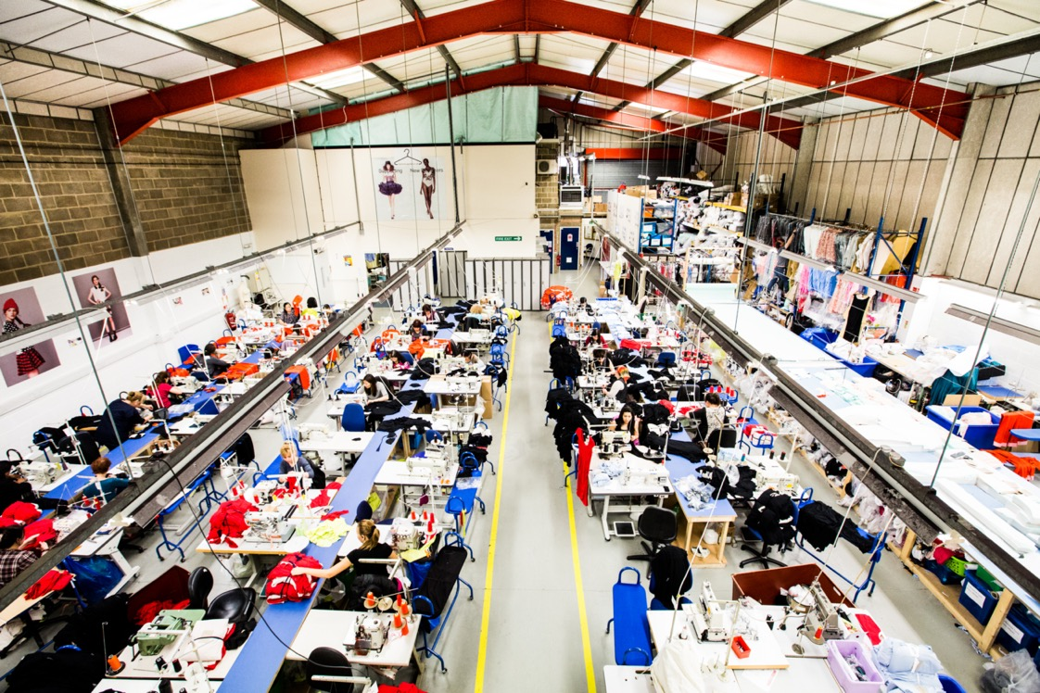
FEL Has Two Missions;
FEL has two mission statements
+ To be a centre of excellence for design, patterns, grading, production. FEL's services can offer a client a one off sample to 30,000 garments a week.
+ To be a centre of excellence for education and learning from their sites in London, Islington, Leicester and Wales. Qualification attainment from level 1 - 5 plus apprenticeships.

Slide 3

Fashion-Enter Limited
Fashion-Enter Ltd (FEL) is an award-winning social enterprise which is a centre of ethical garment manufacturing with a leading status in the Fast Forward audit and is also SMETA audited. FEL has a minimum order quantity of 1 for their Fashion Studio service and currently
produces up to 30,000 garments a week for speed of response fashion from their three units in Haringey, North London and Wales.
Clients include ASOS, N Brown and Simply B, I Saw it First, Brora, Jaeger (M&S) and brands such as Louisa Parris and Gormely and Gamble.

Slide 4
FEL Has Two Mission Statements;
FEL has two mission statements
+ To be a centre of excellence for design, patterns, grading, production. FEL's services can offer a client a one off sample to 30,000 garments a week.
+ To be a centre of excellence for education and learning from their sites in London, Islington, Leicester and Wales. Qualification attainment from level 1 - 5 plus apprenticeships.

Slide 5
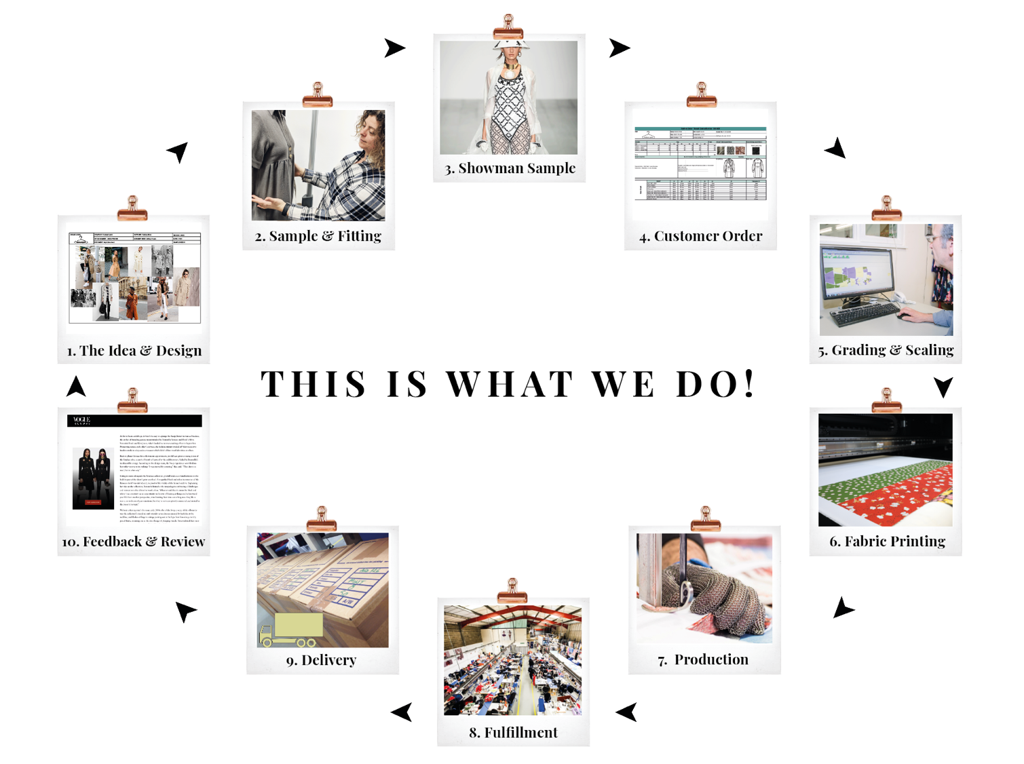

Slide 6

Types of Audits
Ethical auditing
Quality auditing
Security auditing

Slide 7
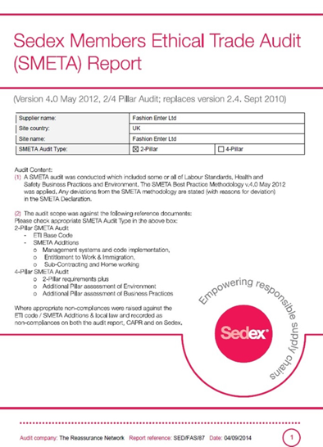
What Makes a Factory Compliant?

Slide 8
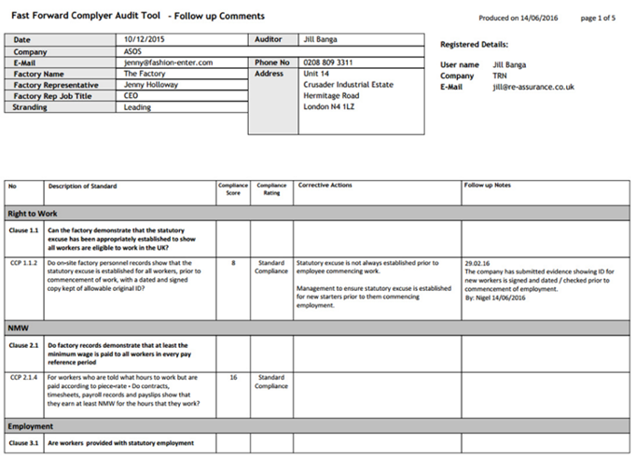
Fast Forward Audit

Slide 9
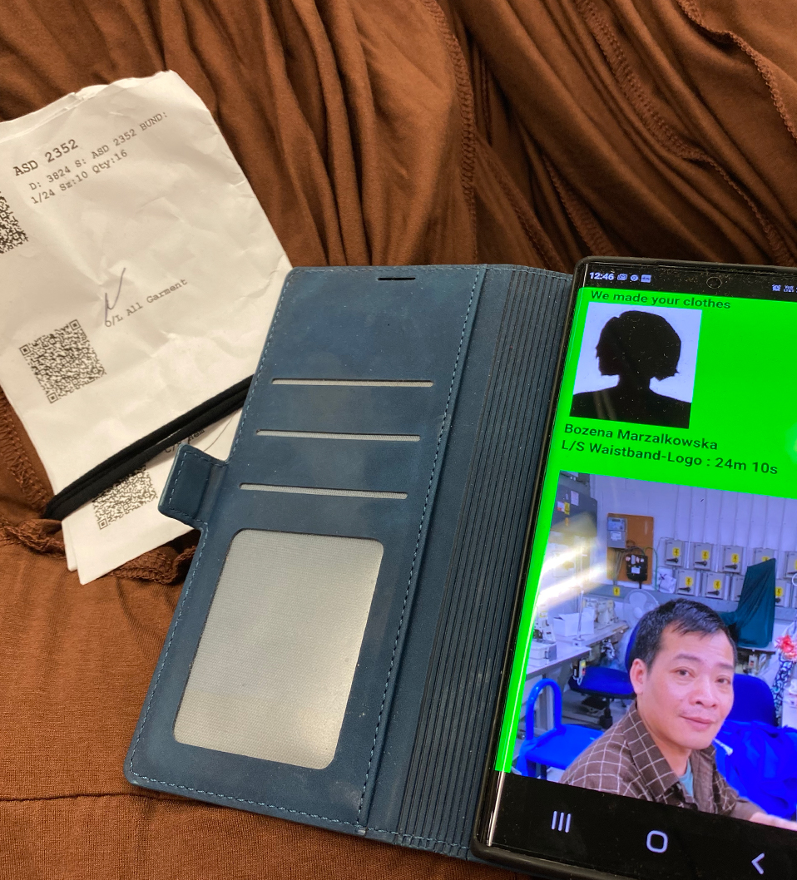
Verification & Authenticity
Adding a secondary Identification at the end of the manufacturing process such as a SofMat 3D Matrix provides 2 factor Authentication removing the opportunity for fakes to enter the market when dealing with High Value goods.
Any access for data will require the 2 forms of ID to be verified as linked with failure denoting a suspect or fake item.

Slide 10

Social Values

Slide 11
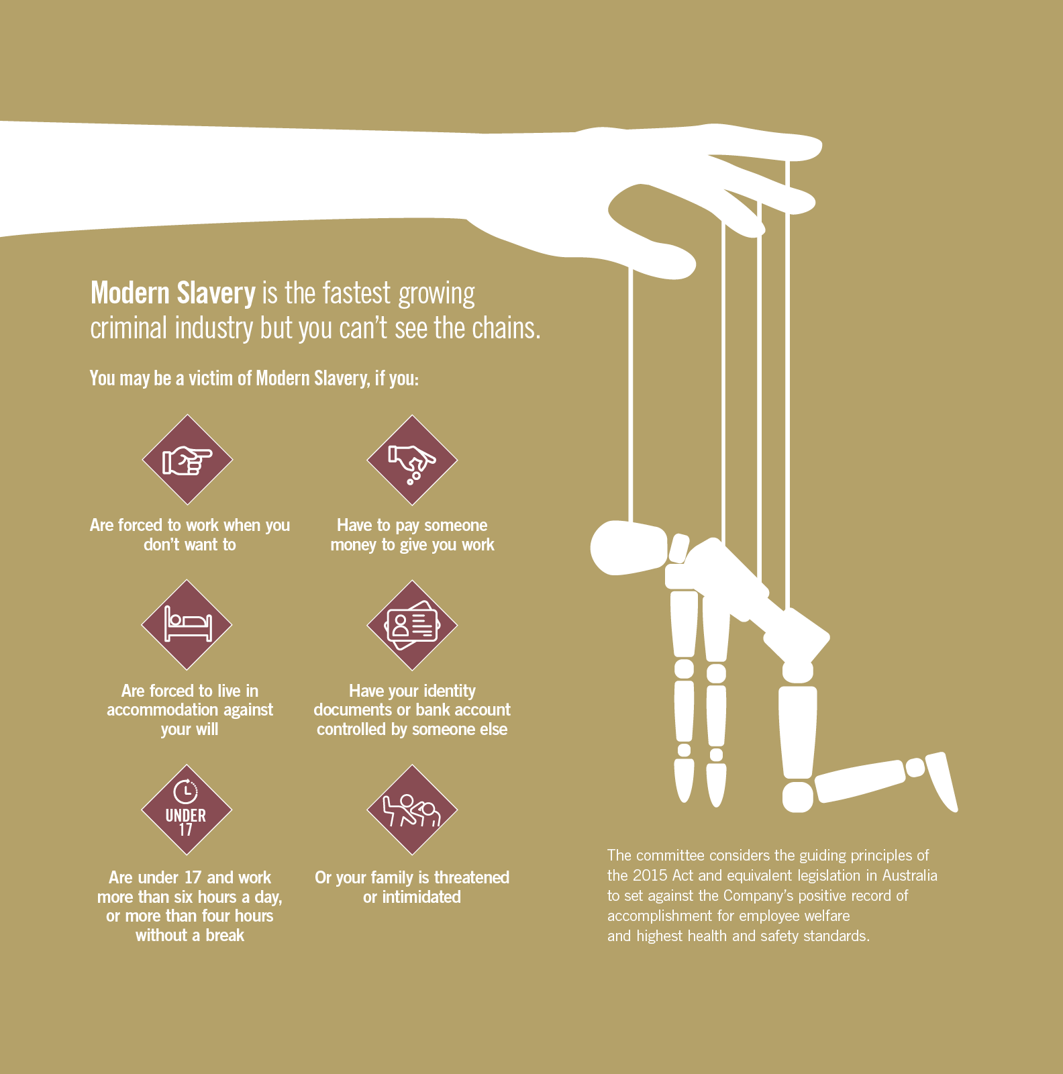
Modern Slavery Act – Labour Exploitation
Agriculture and fishing
Domestic work
Construction, mining, quarrying and brick kilns
Manufacturing, processing and packaging
Prostitution and sexual exploitation
Market trading and illegal activities
Level 1 Award – Workers Rights and Labour exploitation

Slide 12
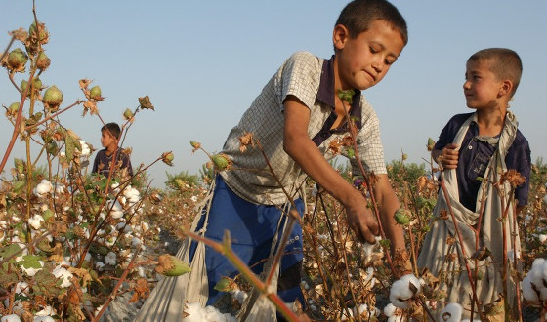
Working with the AGM PPP
Apparel and General Merchandising Public/Private Protocol (AGM PPP)
The resurgence of the UK Apparel and General Merchandise supply chain presents an opportunity for brands, retail and manufacturers to invest and to create new jobs. However, this re-emergence has been beset by widely publicised reports by media, labour rights organizations, academics and NGOs, of routine denial of rights and egregious exploitation of in UK textile factory workers.
While there have been initiatives taken by a number of stakeholders to tackle these problems, there has not to date been a coordinated approach that brings together the industry, from manufacturers to retail, workers and those that represent them, government both national and local, with others such as community groups and associations.
A Terms of Reference is being developed to provide a framework for an inclusive Protocol, creating a coordinated approach to realise the potential of the UK Apparel and General Merchandise industry.
AGM PPP Mission
We will work together to improve employment and working conditions and eradicate slavery and exploitation in the Apparel and General Merchandise supply chain in the UK by:
Raising awareness to prevent the exploitation of workers
Protecting vulnerable and exploited workers
Disrupting exploitative practices and bringing criminals to justice
Protecting the rights of all workers and promoting decent work, ensuring the inclusion of worker and community voice
Adjudicator

Slide 13
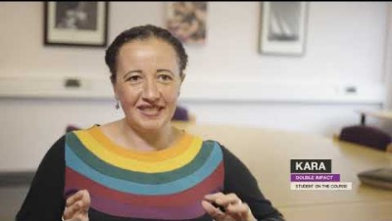
Level 1 Workers’ Rights & Labour Exploitation
This course has been developed to raise awareness of the basic employment rights provided by UK law. The student will gain an understanding of the job application process and how to spot if an advertisement is genuine or not. They will also gain the tools to understand whether themselves or a colleague, are being exploited and the process to report this exploitation. This qualification has been designed in conjunction with the Gangmasters Labour Abuse Authority.

Slide 14
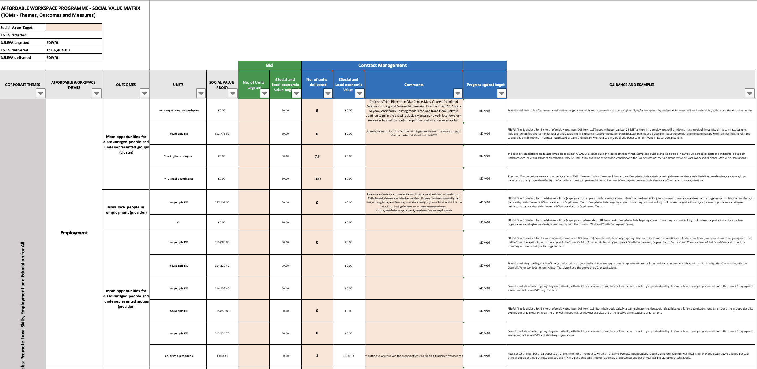
Case Study
FC Designer Collective - Case Study
FEL has a contract with Islignton Council, GLA and LEAP which is a capital £10m fund for ten years. Conversion of a derlict underground car park to incubator units for creatives. Retail shop 1130115 Fonthill Road to create a circular economy. FEL has TOMs to achieve - Themes, Outcomse and Measures that guide social value.

Slide 15
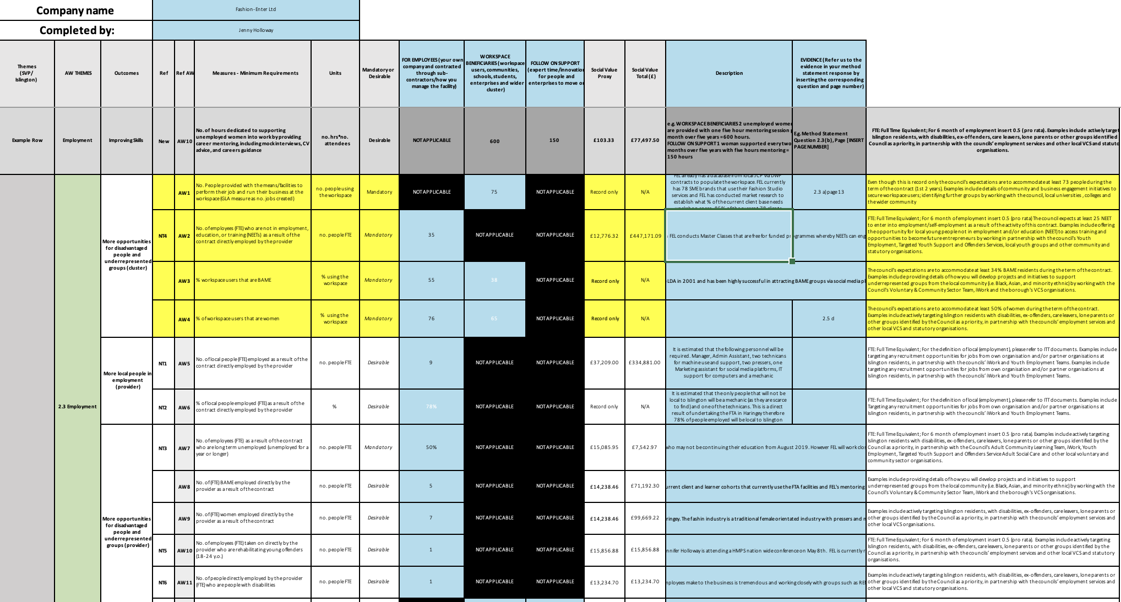
Social value matrix
Social Value Matrix Explained £106K Sept 22

Slide 16

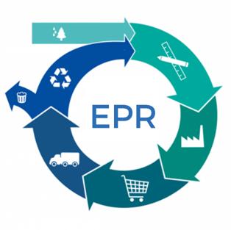
Extended Producer Responsibility
With the rise of clothing consumption, a reduction in demand for the export of used textiles, and the resulting growth in UK textiles ending up in landfill, textiles is now a strong candidate for the application of an EPR or ‘polluter pays’ policy
This can incentivise waste prevention at the source and promote lower impact product design, and supporting wider public re-use and recycling.
EPR has the potential to influence design, encouraging products to be reusable, repairable, and durable plus recyclable

Slide 17
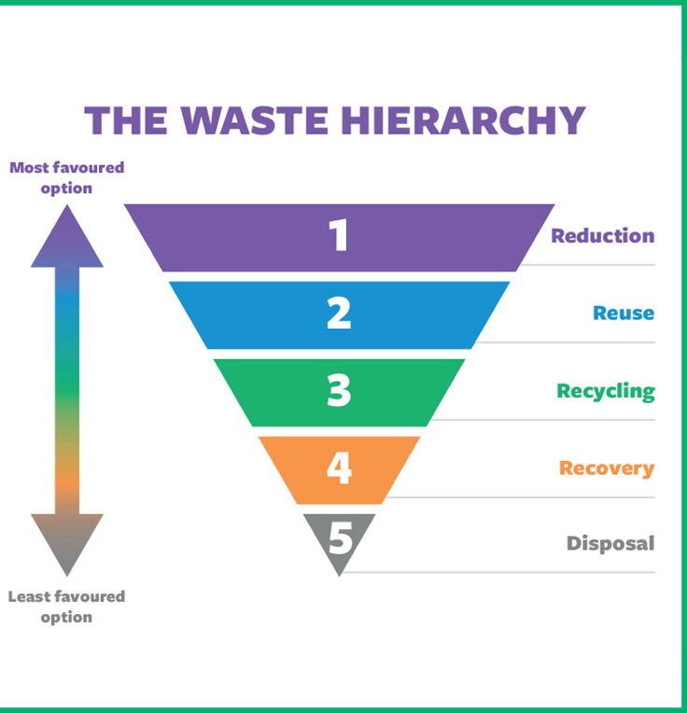
For EPR systems going forward, products have to be scored against a set of criteria as part of a system called eco-modulation. Under eco-modulation, the fees paid by the producer vary according to specific criteria relating to aspects of their products’ environmental performance. The more ‘environmentally-friendly’ products are charged at a lower rate than those that are less ‘environmentally friendly’ to incentivise eco-design. We will need to incorporate recycled content, improving durability, making products more repairable, and integrating reuse into business models. Another key area is in relation to so-called ‘product passports’- providing detailed information on materials for users and recyclers; particularly important given the known inaccuracy of garment labels today.”
We will need to use more durable and lower carbon materials, including organic and recycled materials, and making clothing genuinely recyclable. Single materials are so much easier to deal with than mixed materials such as poly-cottons and cotton-elastane mixes, it may be that the very worst materials, from an environmental performance point of view, will actually be excluded in the future through minimum eco-design requirements for market entry.
EPR - How?

Slide 18

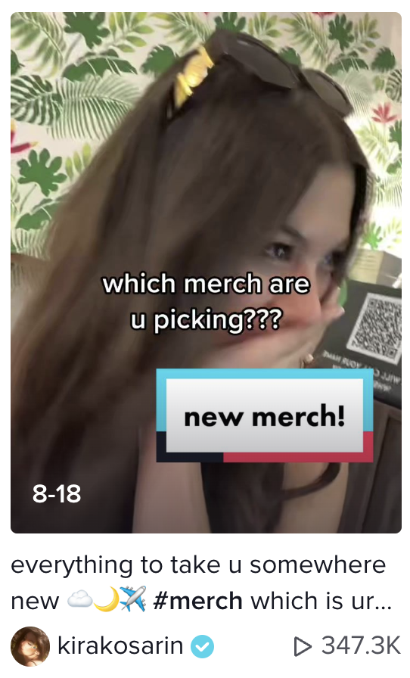
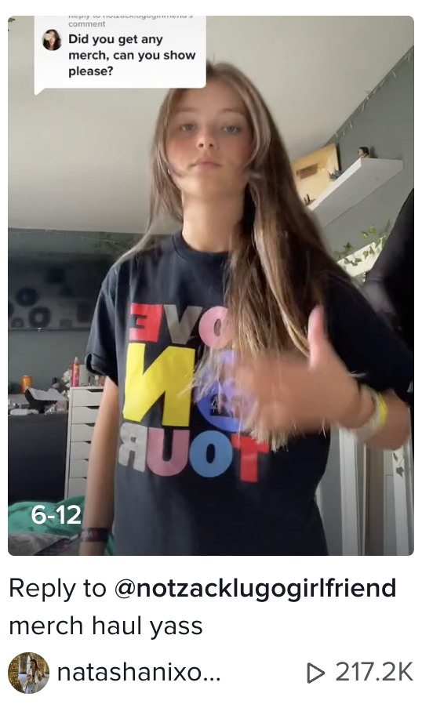
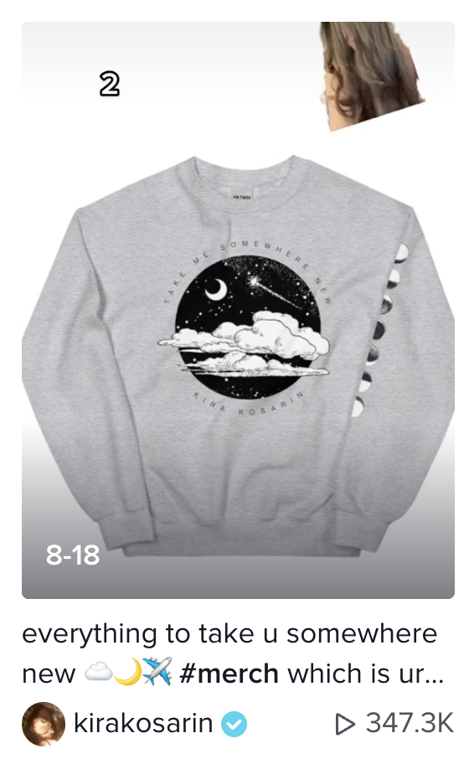
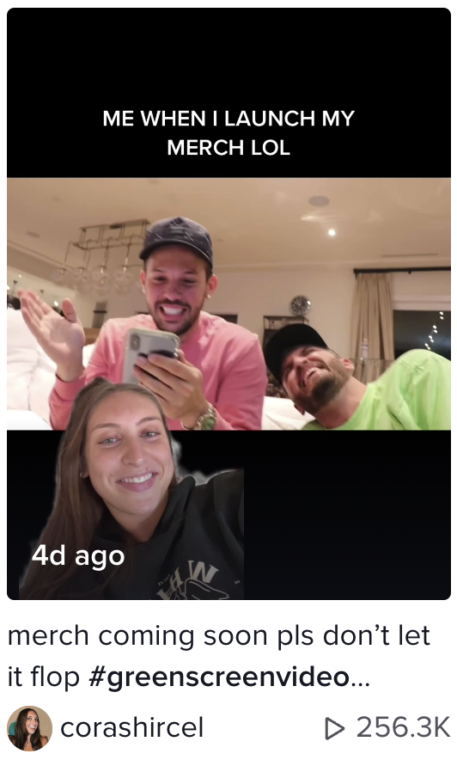
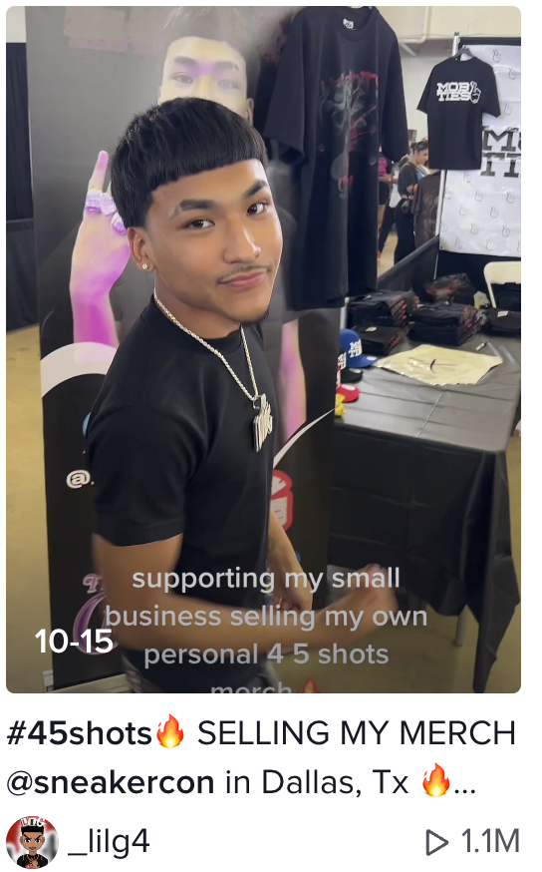
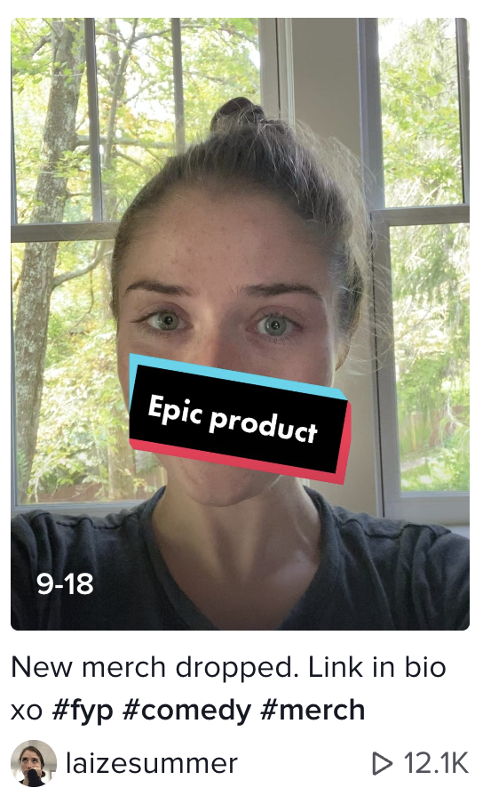
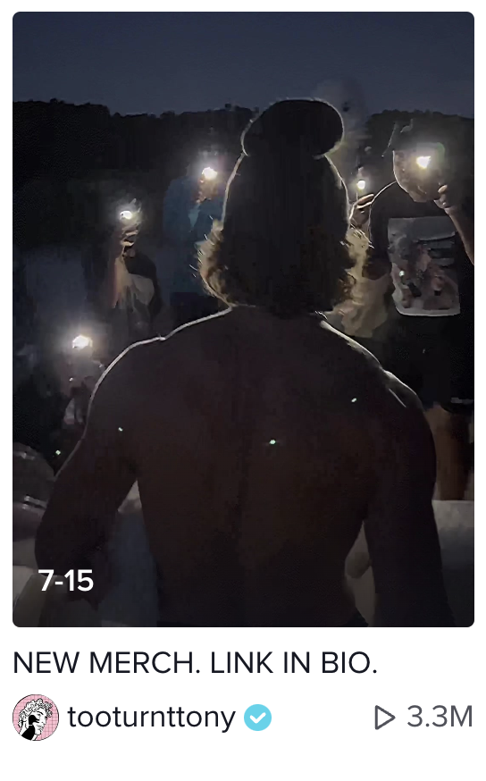
Be Aware the Creatives are Coming!

Slide 20
Contact us!
Fashion-Enter Ltd | FashionCapital | FCFTA (HO)
A: Unit 4, 13/14 Crusader Industrial Estate, 167 Hermitage Road, Haringey, London, N4 1LZ
T: 0208 809 3311
E: info@fashion-enter.com | Education@fashion-enter.com
W: www.Fashion-Enter.com | www.FashionCapital.co.uk | www.FCFTA.com
Fb: @fashioncapital | In: @fashioncapitaluk | Tw: @FashionCapital | Li: @fashioncapital
Fashion-Enter Ltd (Wales)
A: The Royal Welsh Warehouse, 17 Old Kerry Road, Newtown, Powys, SY16 1BJ
T: 0168 624 8148
E: FELWales@fashion-enter.com
Fb: @FashionEnter | In: @fashionenterltd | Li: @Fashion-Enter
FCFTA (Leicester)
A: Top Floor, Black and Yellow Building, 30 Stonebridge Street, Leicester, LE5 3PA
T: 0116 436 2560
E: Fcftaleicester@fashion-enter.com
Fb: @FashionTechnologyAcademy | In: @fashiontechnologyacademy | Tk: @fashiontechnologyacademy
FC Designer Collective
A: 113-115, Fonthill Road, London, N4 3HH
T: 0203 026 0388
E: FCdesignercollective@fashion-enter.com
In: @fcdesignerworkspace

